Slide 1
Growing Like China
Speaker: Sisley. Zhu
Author: Zheng Song, Kjetil Storesletten and Fabrizio Zilibotti
Source: The American Economic Review, Vol.101, No. 1( Feb 2011)
Notes:
Good afternoon, everyone
Today I am gonna talk about a paper that explained an interesting growth pattern in China.
The name is Growing like China.
Some parts of the paper involved lots of tedious mathematical derivation . I will try my best to use the plain English to help you understand the general idea

Slide 2
Outline
The Puzzle
Empirical Evidence
Benchmark Model
Equilibrium Characters
Wrap Up
My opinion
Notes:
This is the outline for today's speech
First, we introduce the puzzle in China's economic model.
We will review some empirical evidence in this model.
And then we will construct our benchmark model to try to explain if the results match the evidence.
Final part is my opinion.

Slide 3
Let’s back to our ECON 100 class…
Notes:
Ok !
Let's back to our ECON 100 class for a second to review some basic economic theories

Slide 4
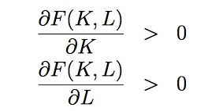
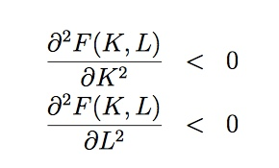
Closed Neoclassic Economic Model
Y = AF ( K , L )
Labor
Capital
Production function
Technology Level
GDP
Notes:
The first model we need to look at is the closed economic model
It's closed meaning you cannot trade with other countries. You can only trade within one country.
There are three factors that could affect the total output of the economy.
Capital, labor and technology
When we take first derivative
When we take the second derivative, there's a diminishing effect of marginal return of capital here.
When we inject more and more capital to a system, the final output should increase. But the growth rate of the output should actually decrease.

Slide 5
Open Economy Model
Saving – Investment = NX (Net Exports)
Saving > Investment NX > 0 | Saving < Investment NX< 0
Lend To Foreigner | Borrow From Foreigner
Trade Surplus | Trade Deficit
Net Capital Outflow > 0 | Net Capital Inflow > 0

Slide 6
The Puzzle
PUZZLE!
CHINA
？
Growing
Trading Surplus
Neoclassical Economic Model
High Growth
？
High Return to Capital
Open Economic Model
Notes:
Over the last 30 years, China has undergone a spectacular economic transformation.
We have seen there’s a high growth rate and investment rate for the whole economy.
However, the combination of high growth and high return to capital, on the one hand, and a growing foreign surplus, on the other hand, is puzzling.
These two results are contradicted with what we predict in the two classical economic model.
That’s the puzzle!
A closed economy model predicts that a higher investment rate would lead to a fall in the return to capital
An open economy model predicts a large net cash inflow rather than outflow
And the general idea of this paper is to create a growth model to resolve this puzzle, at the same time. Be consistent with the reality of China’s economic transition.

Slide 7
General Idea
Construct a growth model to resolve this puzzle in China
At the same time, be consistent with China’s economic transition:
High Output Growth
Sustained Returns
Large Trade Surplus
Notes:
There are three main features appeared in this economic transition.

Slide 8
Timeline
Our focus would be here !
1978
1992
1997
First Economic Reforms
New stage of reform launched
Deng Xiaoping’s Southern Tour
Reforms Acceleration
15th Congress of the Communist Party of China
Endorsed increase of private firms
Notes:
Before we look further into the model ,we need to clarify the timeline of our whole analysis.
You could see that the first economic reforms happened in 1978.
A new stage of reform finally launched until 1992 when our leader Deng finished his southern tour in China.
Another political events happened in 1997, which is the 15th congress of the communist party of china. In that congress, most of parties endorsed the increase of private firms. So the economic reforms accelerated at that time.
And our main focus for this paper is after 1992, a period characterized by the fast and stable growth and by a pronounced reallocation resource within the manufactured areas

Slide 9
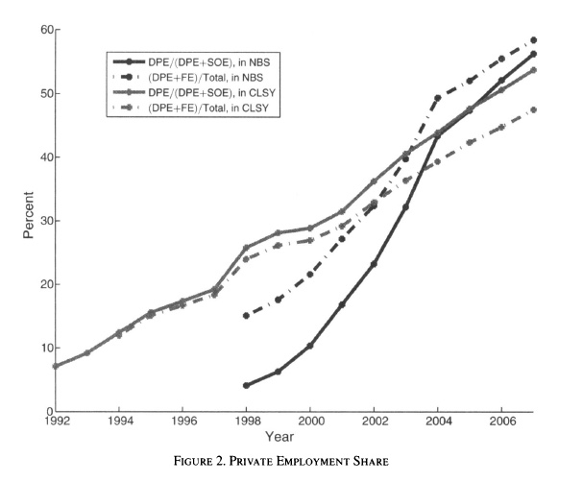
Reallocation in Manufacturing
Domestic Private Enterprises
State owned Enterprises

Slide 10
DPE vs SOE
Domestic Private Enterprises | State Owned Enterprises
More productivity | Less productivity
Strong discrimination to credit markets | Easily get external funding from credit markets
Rely heavily on internal funding E.g.: retained earnings and family or friends to finance investment | Rely on external financing E.g.: major bank mortgage

Slide 11
Income Inequality
In this economic transition, China experienced a increase in income inequalities.
Gini Coefficient of income in China grew from 0.36 in 1992 to 0.47 in 2004
The slow growth of wages relative to entrepreneurial income
More private firms ->higher income dispersion

Slide 12
Foreign Surplus and Productivity Growth
Use data for 31 provinces with NBS data from 1992 to 2004 to perform regression
Foreign Surplus:
Y = Net Surplus-to-GDP ratio ; X = employment share of DPE
Results: The net surplus is systematically larger in provinces with a larger increase in the DPE employment share which lead to foreign surplus.
Growth Rate:
Y = Growth rate of GDP ; X = employment share of DPE
Results: Labor productivity has grown faster in provinces where the DPE employment share has grown faster.

Slide 13
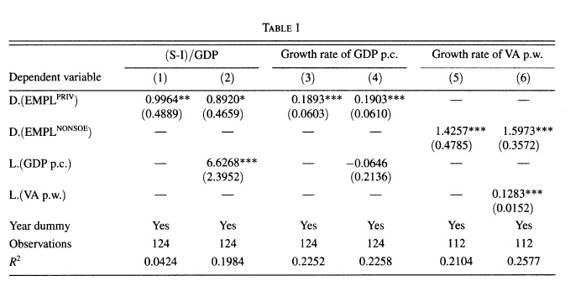
Foreign Surplus and Productivity Growth
Notes:
The result is positive and highly significant
Perform a regression on the net surplus-to-GDP ratio on the percentage of domestic private firms.

Slide 14
The Benchmark Model

Slide 15
Model Setup : Populations
“I am a worker. I don’t have entrepreneurial skills . ”
N_{t}
N_{t+1} = N_{t} (1+v)
Agent a
“I am a worker. I have entrepreneurial skills . ”
µN_{t}
N_{t+1} = N_{t} (1+v)
Agent b

Slide 16
Model Setup : Population Utility
Time-separable utility function
Assumption:
Two-period lived agents will work
in the first period and live off
savings in the second period.
C_{1t} : Consumption @ 1t
ϴ > = 1: the intertemporal elasticity of substitution in consumption C_{t}
Beta : discount factor

Slide 17
Model Setup : Firms
Owned by intermediates
Operate as a standard neoclassical firm
Access to credit markets
Retained direct control
Financial Integrated Firms
Firm F
Owned by old entrepreneurs
Hire their own children
Restricted external funding
Delegate decision authority to the manager
Entrepreneurial Firms
Firm E

Slide 18
If Firm F choose delegation…
Firm F
Advantage:
Delegation leads to higher Total Factor Productivity.
Manager make decisions based on superior information
Firm could attain 𝒳 > 1 extra efficiency units per worker compared with Firm E
Disadvantage:
Agency problem: the manager can divert a positive share of the firm’s output for his own use
Solution is to pay managers a compensation that is at least as large as the funds they could steal
Notes:
Trade off here to explain these two kinds of production modes
We assumed that Firm F are weak at corporate governance and cannot effectively monitor their managers.

Slide 19
But for Firm E …
Key assumption is that entrepreneurs are better at monitoring their managers
So that Firm E managers can steal only a share 𝜓 < 1 of output
Notes:
Sign

Slide 20
Model Setup : Technology
A: Technology Parameter. A_{t+1} = (1+z)A_{t}
K : Capital
n : Labor
Y : output
Notes:
* As we mentioned in the first several slides, there are three main factors to contribute to the total output of firms.
Technology
Capital
Labor

Slide 21
Model Equilibrium : Agent’s savings
Iceberg Cost : ξ
Domestic Firms
Young Worker
Deposit
Saving S_{t}
Banks
R_{l}
R_{d}
Foreign Bond
Wage w
R
Budget Constraint: C_{1t} + C_{2t+1}/R_{d} = W_{t}
Consumption
Maximize Utility
Notes:
* We now analyze agents’ savings. Young workers earn a wage w and deposit their savings with a set of competitive intermediaries (banks) paying a gross interest rate Rd
* Banks collect savings from workers and either lend it to domestic firms or invest in foreign bonds.
* There is a iceberg cost for banks to lend money to domestic firms ( ksign)
The bond yield a gross return R
Here comes a question. How could the work split his wage so that he could maximize his utility?
To solve this, we need to first examine the budget constraint that should be satisfied for the worker.

Slide 22
Model Equilibrium : Agent’s savings
In competitive equilibrium:
R_{d} = R = R_{L} *(1 – ξ)
Notes:
*In a competitive equilibrium, the rate of return on domestic loans must equal the rate of return on foreign bonds, which in turn must equal the deposit rate.
* Otherwise, there's no equilibrium for the bank if it cannot match these two kinds of cash flow
* In our model ,we will assume that there are no operational cost for lending money, so Rd = RL
* So, if firm F wants to maximize its profit, it would set
# the deposit rate or lending rate equal to the marginal product of capital
#and the wage equal to the marginal product of labor.
* How can we calculate those two marginal amount? ( DO ANYBODY KNOW HOW TO GET THAT? ) OK, NEVER MIND)
We just go back to our output equation of Y. We take derivative of Y w.r.t Capital and labor.
Then we will get the marginal rate of capital and labor!

Slide 23
Model Equilibrium : Agent’s savings
Young Entrepreneur
Banks
Deposit
Consumption
R_{d}
Compensation m_{t}
Lend a limited portion to domestic firms
Repay ŋ share of net profit
Family Business
Notes:
Next we will look at what is the situation for young entrepreneur
It's very similar to the firm F's young worker.
Instead of getting a wage, the entrepreneur will get a compensation mt.
Their savings can be invested either in bank deposits or in their family business.
Notice that for here, the private firms could borrow a limited amount from the bank in the first period.
And in the second period, we assume that they will only repay a (EETA) share of the second-period net profit to the bank.

Slide 24
Model Equilibrium : Agent’s savings
Consider now the value of an E firm, owned by an old entrepreneur with capital K_{Et .}
This value is the solution to the following problem:
Subject to the following incentive constraint:
Thus, the optimal compensation is :
Notes:
The first term in the bracket is the total value of output for Firm E
And the other remaining terms are compensations and wages that the old entrepreneur should pay to his workers.
So the net of there two is the total capital for Firm E
There's a incentive constraint here:
The compensation amount should be greater than the amount the manager could steal from the company.
And we have assumed that in firm E, manager could only steal a SIGN share of the total value the company.
Thus the optimal compensation is achieved when the compensation amount is just equal to the right hide side of the inequalities

Slide 25
Model Equilibrium : Agent’s savings
Taking the first-order condition with respect to n_{E} and substituiting in the equilibrium wage given by (2) yields that
Plugging the above equations to the maximum equation, we get the optimal firm E’s value :
Notes:
Then we take the first derivative of the first equation w.r.t nE and substitute mt , we will get this optimal labor level for Firm E
We plug the optimal compensation amount and labor level to the orignal capital equation, we just get the optimal firm E's value. Which is equal to
日若 E times ket

Slide 26
Model Equilibrium : Agent’s savings
E firms prefer delegation to centralization
Young entrepreneurs find it optimal to invest in the family business
A sufficiently larger productivity difference is necessary to trigger economic transition!
Notes:
Here 日若e is the firm E's rate of return to capital
Another thing we need to clarify is that ,firm E must have enough money to repay his bank loan
So that marginal return to capital for firm E shoud be greater than the lending rate.
We do some algebra transformation and arrived at the following assumption condition.
Kai
Three points need to be emphazied here.
First of all, firm E prefer delegation to centralization. That's why we get the incentive constraint.
Secondly, young entrepreneurs find it optimal to invest in the family business instead of consumption.
And the last point is......

Slide 27
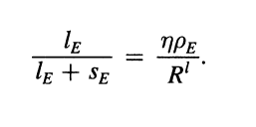
Model Equilibrium : Agent’s savings
Firm E’s capital k_{Et} is composed of:
Incentive-compatibility constraint of the entrepreneur
The share of investments financed through bank loans is :
C₁ = m – S_{E}
C₂ = ρ_{E} ( l_{E} + S_{E} ) – R_{l} l_{E}
Notes:
Next, we look at firm E's capital in more details.
The total capital is composed of total savings from the first period and the amount they borrow from the bank.
There's also an incentive constraint here for the whole company.
The amount they could repay in the second period should cover the amount they are required to repay to the bank
The optimal condition is that inequality becomes equal. So we get this ,the share of investments financed through bank loans.
And also according to our set up, the consumption amount in the first period is equal to the compensation deducted by the saving
In the second period, this is just equal to the total capital return minus the amount they repay to the bank.
So now we can solve the maximize problem for the total utility.
Ei-ta

Slide 28
Model Equilibrium : Agent’s savings
Maximize the utility function with the above constraints
Notes:
We just plug all the above equation to the original utility function. And we take derivatives with respect to saving amount.
Now we have got the optimal saving amount is this expression.
Zeeta

Slide 29
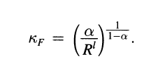
Equilibrium Characters
Capital per effective unit of labor
k_{J} = K_{J} / (A_{J} n_{J} )
Lending R_{d} = Marginal product of capital of F firms
Thus, we substitute the above equation and put into n_{E:}
Notes:
Actually there are three important lemmas that could explain why China acted differently as the classical economic model in this transition.
We define a new concept here, that is the capital per effective unit of labor denoted by small k
It is the ration of the total capital and the product of labor an technology.
We just plug these two equations to the optimal labor level for firm E , then we will get this relationship between firm E and F
You could see that as long as the coefficient behind kF is smaller than 1 , ke will alway be smaller than kf

Slide 30
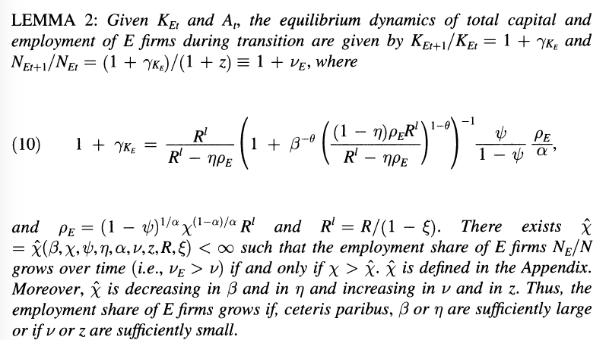
Equilibrium Characters
Notes:
Lemma 2 looks very complicated
We will skip the derivation of this lemma.
They just examine different growth ratio to the three main factors that affect the total output.
And the finally result is that employment, capital and labor would grow at the same rate in this economic model.

Slide 31
Equilibrium Characters
K_{ET} and A_{t} are state variables
Capital per effective unit of labor for each type of firm, k_{E} and k_{F}, is constant for each type of firm
Entrepreneurial savings in period t is linear in K_{ET}
The employment, capital and output of E firms grow at a constant rate during transition

Slide 32
Equilibrium Characters
For firm F:
Firm F hire all workers not employed by Firm E and KF adjusts to the optimal capital-labor ratio
As long as the employment share of E firms increases, the growth rate of KF declines over time.
The aggregate capital accumulation of F firms is hump-shaped during the transition.
Initially, when the employment share of E firms is small, KF grows at a positive rate. However, as the transition proceeds, its growth rate declines and eventually turns negative
Notes:
Another relationship we need to notice is that,
Firm F will hire all workers not employed by firm E and Kf adjust to the optimal capital-labor ratio.

Slide 33
Equilibrium Characters
Average rate of return for the all economy is :
Indicates that as long as N_{et}/N_{t} increases, the 𝝆 will increase
Hence, explain the reason that the increase of private enterprises accounts for the consistent growth of China’s capital return
Notes:
We can divided the total rho e into the following expression.
And the main idea here is : as long as NET/NT increases, the rho will increase.
Which means as long as the percentage of domestic private firms increase, the marginal capital return of China's economy should increase.
This explains the unusual result that China demonstrated in this economic transition

Slide 34
Transition Dynamic
Notes:
There are few charts to show the relationships between labors, capital and returns with the transition time.

Slide 35
One more PUZZLE….
Foreign Surplus
Notes:
Now we have explained the unusual higher return to capital .
And there's one more puzzle left. That is the foreigner surplus!

Slide 36
Equilibrium Characters
Let’s look at the bank’s balance sheet
Loan to F
Loan to E
Foreign bond
Deposit
Notes:
To solve this puzzle, let's first look at the bank's balance sheet.
You see from this equation here. The left hand side is the asset of the bank. It includes the loan to firm F and Firm E. It also includes the investment amount to the foreigner bond.
The right hand side is the liability for the bank. It is the deposit they should pay back to workers.

Slide 37
Equilibrium Character
As long as the N_{ET}/N_{t} increases, the country’s foreign surplus per efficiency unit, B_{t}/(A_{t} N_{t}) increases.
When the transition is completed in period T and all workers are employed by E firms (N_{ET}/N_{t} = 1), the net foreign surplus becomes:
If the E firms remain sufficient credit constraints (i.e the ŋ is very low), then the transition necessarily ends with a positive net foreign position
Notes:
We modify this equation and plug in the optimal amount for wages or capitals for these two different firms.
And we get the optimal foreign bond amount, which is exactly the foreigner surplus
We could see from this expression. As long as the percentage of private firms increase, the foreign surplus would keep increasing.
That's why we see a growing trade surplus in this China's economic transition

Slide 38
Notes:
Ok !
We have resolved the puzzle!

Slide 39
Wrap-Up
In spite of high investment and growth rate, the rate of return of firms does not fall
E firms(DPE in China) have a higher TFP and less access to external financing with a low capital intensity
Growing like China
The transition is characterized by factor reallocation from financially integrated firms to entrepreneurial firms, similar to SOE to DPE
Such reallocation leads to an external imbalance- sustained foreigner surplus
Notes:
Here is a little wrap up for the whole idea

Slide 40
My opinion
It is a well-constructed model , which implements data, economic theory and quantitative methods to successfully explained the economic transition in China after 1992
However, some assumptions are not appropriate and need to be readjusted
E.g. : while assuming F firms to be competitive, the author ignored the market power of the firm, that may be important in Chinese SOE.
Deserves further researching on granting market power of Firm F to see if the results would change.

Slide 41
Notes:
That's it!
Thank you!

